Slide 1

AMBALIKA
CENTER OF EXCELLENCE

Slide 2

CREATING FUTURE READY ENGINEERS

Slide 3

NEED FOR Center Of Excellence
Wide gap between Academics and certified practical knowledge of modern technologies.
There is need to bridge the gap.
The center plays a vital role in transforming the fresh engineering graduates into readily employable professionals.

Slide 4





Industry Partners
Joint certification programs of innovative technologies with the Industry giants.
MICROSOFT
KUKA Robotics
SIEMENS
ACE Micromatics
Master CAM
Oracle AutoCAD
PLC

Slide 5

ROLE OF AMBALIKA
Ambalika is playing the role of facilitator in forging relationship between industry and students.
Additional space has been created at our campus for training on equipment’s used in industries to enable to comprehend the “know how” of innovative technologies.
Weekend support at city center
Offer supplementary education to the students.

Slide 6


Make up for the deficiencies of the academic programs and curricula.
Joint certification courses on cutting edge, upcoming technologies like :
Automation
CNC Milling
CNC lathe
Pneumatics
Advanced robotics
Sensorics
PLC

Slide 7


KUKA Robot At Ambalika

Slide 8
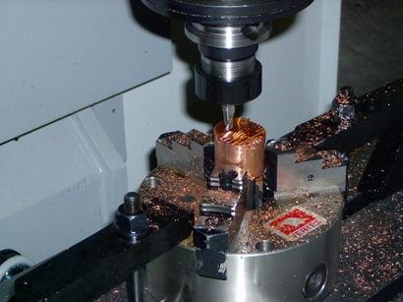
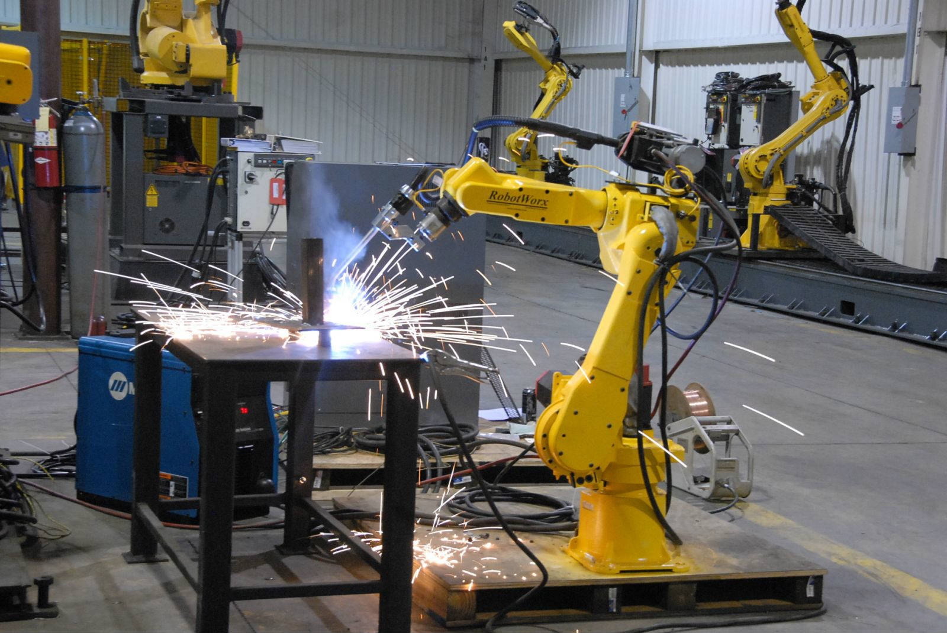
Industrial Automation
High Speed CNC Drilling

Slide 9

CNC ROUTER WOOD CARVING AT AMBALIKA

Slide 10

JOIN AMBALIKA
TO BECOME A
HI TECH ENGINEER
THANK YOU !

